Slide 1
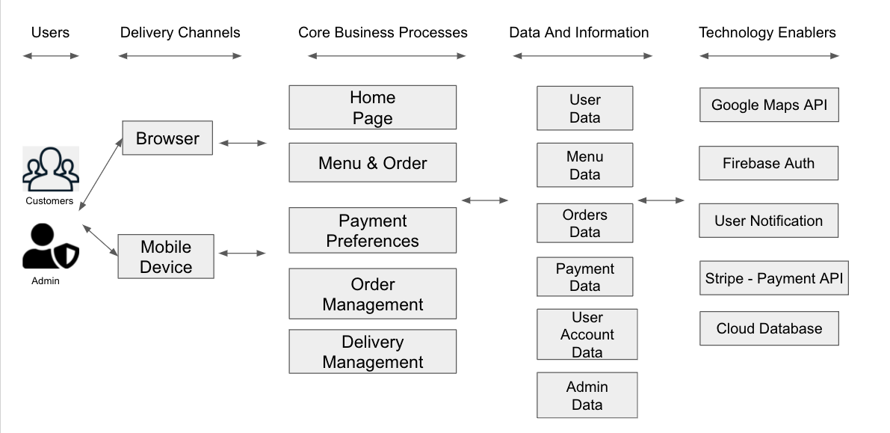
Inwood Bagels Web Application Architecture Type: Application Architecture View: Logical View Style: Layered Architecture Pattern
Cloud Functions

Slide 2
Inwood Bagels Web Application Architecture Type: Application Architecture View: Logical View Style: Layered Architecture Pattern
REVISION NOTES
What changed:
Since the RCT was modified, Core Business Processes Column was modified, too, in accordance with the new Core Features;
In The Technology Enables Cloud Functions were added (in order to go Serverless)
In the technology enables section, the Delivery Services API was deleted as we will not be using an API to add delivery services to our website. Grubhub allows business owners to simply add a order delivery button on a business website, which will direct customers to a restaurants Grubhub page (in this case Inwood Bagels).

Slide 3
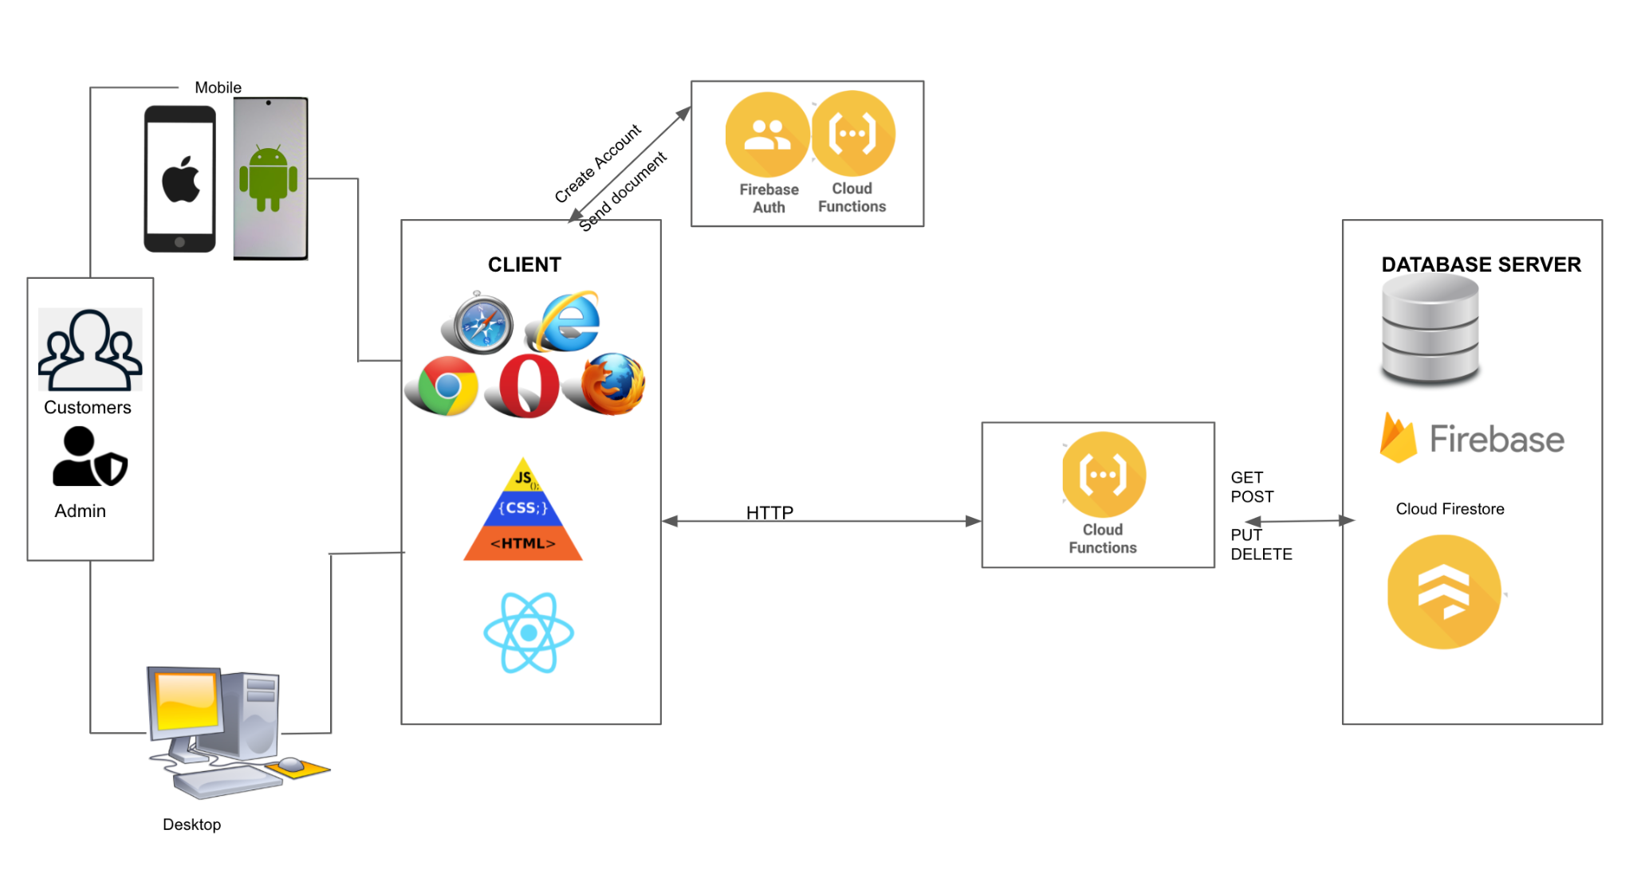
Inwood Bagels Web Application Architecture Type: Application Architecture View: Process View Style: Client-Server Pattern

Slide 4
Inwood Bagels Web Application Architecture Type: Application Architecture View: Process View Style: Client-Server Pattern
REVISION NOTES
After researching during the break, the Lead Developer concluded that Inwood Bagels project will be Serverless React Firebase Application using Cloud Functions.
The benefits include:
This frees up time and resources that can be focused on working on the actual business logic of application.
According to the Firebase Cloud Function documentation:
Cloud Functions for Firebase let’s you automatically run backend code in response to events triggered by Firebase features and HTTPS requests. Your code is stored in Google’s cloud and runs in a managed environment. There’s no need to manage and scale your own servers.
We do not need to build up a server and the app would not use an API to communicate with the server and issue requests. This will be beneficial in terms of money - no need to pay for the deployment

Slide 5
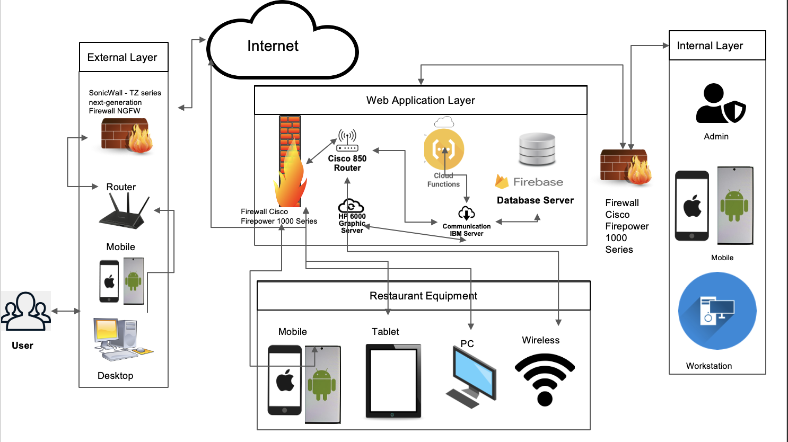
Inwood Bagels Web Application Architecture Type: Application Architecture View: Physical View Style: Layered Architecture Pattern

